Slide 1
DIFFUSION OF INFORMATION USING CONTAGION MODELS IN REAL LIFE SMALL WORLD NETWORKS
HARSHITA PRIYADARSHINI(1451007)
ANKITA PANDEY (1451008)
DEBOPRIYO BHATTACHARYA(1451113)

Slide 2
NETWORK DYNAMICS
An individual’s choices depend on what other people do.
This has informed the use of information cascades and network effects to model the processes by which new ideas and innovations are adopted by a population.
One’s interactions with the rest of the world happen at a local, rather than a global level.
One is likely to choose something that is compatible with the people he interacts with, rather than the choice that is globally most popular.

Slide 3
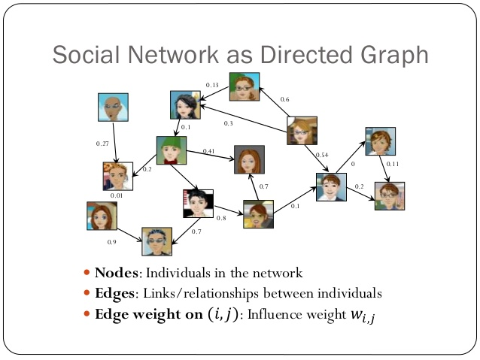
MODELS OF INFLUENCE
A social network can be represented by a directed graph, G.
Each node can be either active or inactive.
Each node’s tendency to become active increases monotonically as more of its neighbours become active.

Slide 4
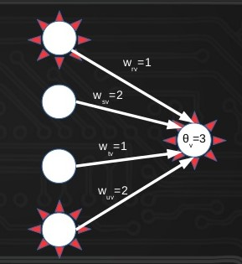
LINEAR THRESHOLD MODEL
A node ‘v’ is influenced by each neighbour ‘w’ according to a weight t bv,w ≥ 0 such that ∑ bv,w ≤ 1.
Each node has a threshold.
Activates if weighted sum of inputs reaches or exceeds threshold.

Slide 5
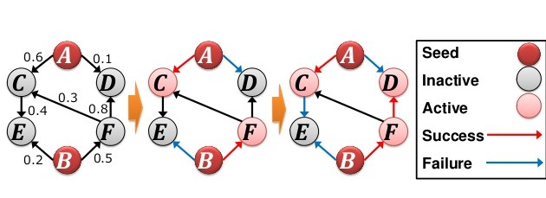
INDEPENDENT CASCADE MODEL
Process starts with an initial set of active nodes.
Each active node has a single chance to activate each currently inactive neighbour ‘w’
It succeeds with a probability pv,w – a parameter of the system.
Successful or not, it cannot make any further attempts to activate ‘w’ in subsequent rounds.

Slide 6
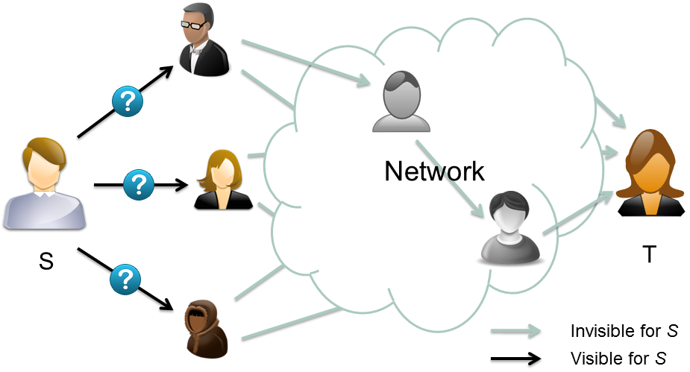
SMALL WORLD PHENOMENON
Consider a Social Network.
Milgram experiment
- Give letter to random people.
- Select a random target.
- Person should give letter to acquaintance.
Conclusions
- Short paths exist between all people.
- “Six degrees of separation”
- people are able to find these paths.

Slide 7
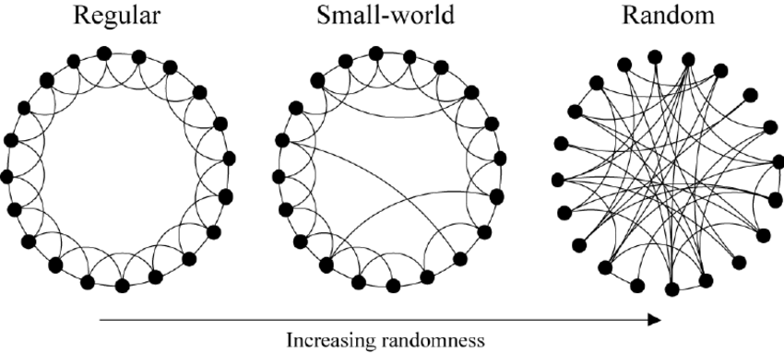
WATTS AND STROGATZ MODEL
It is random graph generation model that produces graph with small world properties.
Proposed by Duncan J. Watts and Steven Strogatz in their joint 1998 Nature paper.
The formal study of random graph dates back to the work of Paul Erdős and Alfréd Rényi.
The graphs they considered, now known as the classical or Erdős–Rényi (ER) graphs.

Slide 8
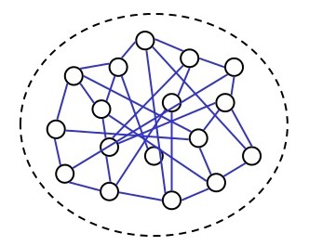
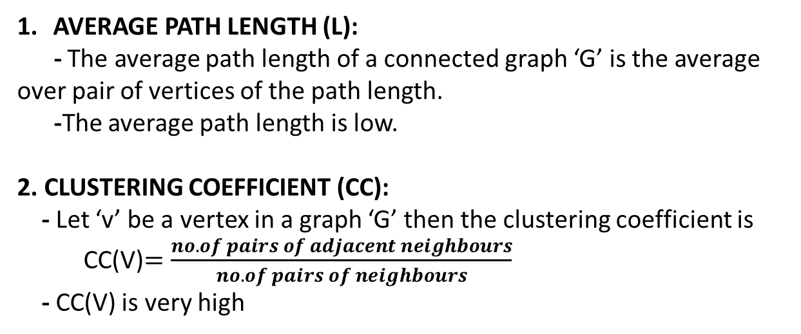
PROPERTIES
AVERAGE PATH LENGTH (L):
- The average path length of a connected graph ‘G’ is the average over pair of vertices of the path length.
-The average path length is low.
2. CLUSTERING COEFFICIENT (CC):
- Let ‘v’ be a vertex in a graph ‘G’ then the clustering coefficient is
CC(V)$=\frac{no. of pairs of adjacent neighbours}{no. of pairs of neighbours}$
- CC(V) is very high

Slide 9
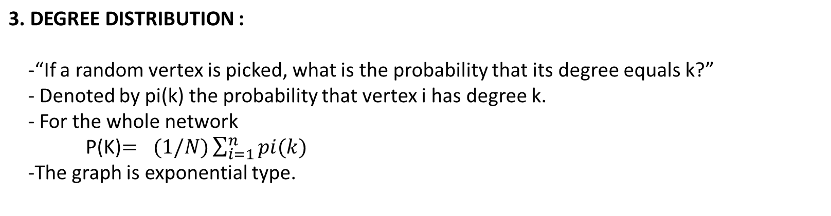
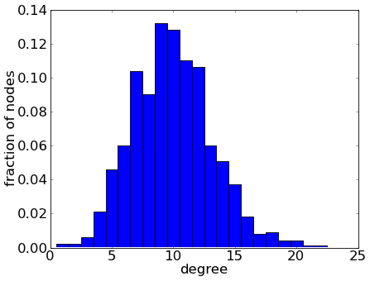
PROPERTIES

Slide 10
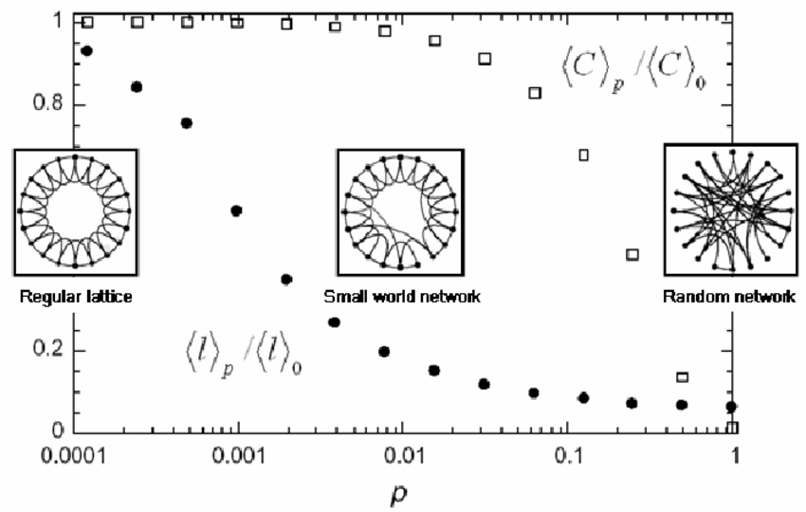
REWIRING
CHANGE IN CLUSTERING COEFFICIENT AND AVERAGE PATH LENGTH
For each node i and each edge (i,j) with i<j and with probability p
- replace (i,j) with (i,k) where k is chosen uniformly from those vertices not equal to or adjacent to i.
L(P) and CC(P) are the average shortest path length and clustering coefficient for a ring lattice with rewiring with probability p

Slide 11
EPIDEMICS ON NETWORK
The study of epidemic disease has always been a topic where biological issues mix with social ones.
The patterns by which epidemics spread through groups of people is highly determined by network structures within the population it is affecting.
The social network within a population — recording who knows whom — determines a lot about how the disease is likely to spread from one person to another.
More generally, the opportunities for a disease to spread are given by a contact network.

Slide 12
CONNECTION TO THE DIFFUSION OF IDEAS AND BEHAVIOURS
There are clear connections between epidemic disease and the diffusion of ideas through social networks.
Both spread from person to person, across similar kinds of networks that connect people
In this respect, they exhibit very similar structural mechanisms
The biggest difference between biological and social contagion lies in the process by which one person “infects” another.
With social contagion, people are making decisions to adopt a new idea or innovation.
With diseases, there is a lack of decision-making in the transmission of the disease from one person to another.

Slide 13
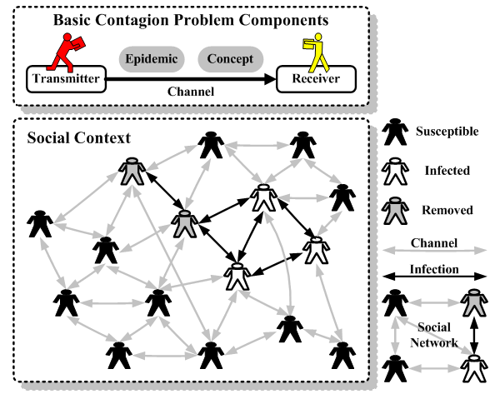
SOCIAL CONTAGION MODELS
Social contagion phenomena refers to various processes that depend on the individual propensity to adopt and diffuse knowledge, idea and information.
There are four basic probabilistic models for spread of epidemics in networks :
SI Model
SIR Model
SIS Model
SIRS Model

Slide 14
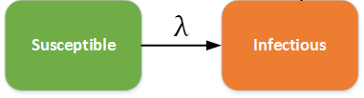
THE SI MODEL
The dynamics of any disease is reduced to changes between a few basic states.
In simplest model, there are just two states:
Susceptible: Someone who does not have the disease yet but could catch it if they come into contact with someone who does.
Infected: Someone who has the disease and can potentially pass it on, if they come into contact with a susceptible individual.
In this situation, people never leave the infectious state and have life-long infections.

Slide 15

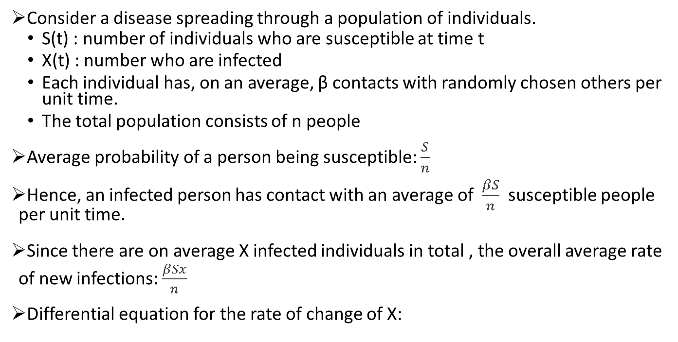
THE SI MODEL
Consider a disease spreading through a population of individuals.
S(t) : number of individuals who are susceptible at time t
X(t) : number who are infected
Each individual has, on an average, β contacts with randomly chosen others per unit time.
The total population consists of n people
Average probability of a person being susceptible: $\frac{S}{n}$
Hence, an infected person has contact with an average of $\frac{βS}{n}$ susceptible people per unit time.
Since there are on average X infected individuals in total , the overall average rate of new infections: $\frac{βSx}{n}$
Differential equation for the rate of change of X:
$\frac{dX}{dt}=β\frac{SX}{n}$.

Slide 16
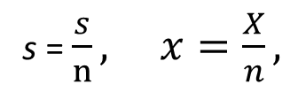
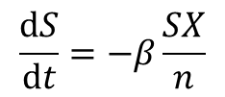

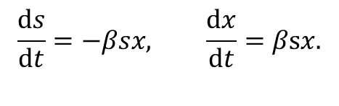
THE SI MODEL
At the same time the number of susceptible individuals goes down at the same rate:
$$\frac{ⅆS}{ⅆt}=−β\frac{SX}{n}$$
Say:
s = $\frac{s}{n}, x=\frac{X}{n},$
Then:
$$\frac{ⅆs}{ⅆt}=−βsx, \frac{ⅆx}{ⅆt}=βsx.$$
Every individual must be either susceptible or infected. So, S + X = n, or equivalently, s + x = 1 => s= 1-x. Thus,
$$\frac{ⅆx}{ⅆt}=β\left(1−x\right)x.$$

Slide 17

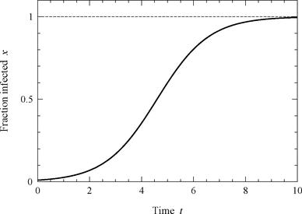
THE SI MODEL
This equation is called the logistic growth equation. It can be solved using standard methods to give:
where x_{o} is the value of x at t = 0.
This produces a S shaped “logistic growth curve” for the fraction of infected individuals.

Slide 18
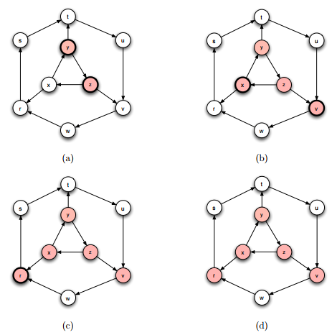
THE SIR MODEL
Extension of SI Model.
Takes into consideration recovery from diseases.
Has two stages:
1st: Susceptible individuals become infected. Contact between individuals are assumed to happen at an average rate β per person.
2nd: Infected individuals recover at some constant average rate γ.

Slide 19




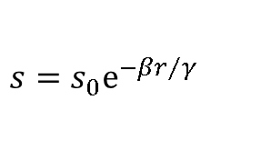

THE SIR MODEL
Here,
And, the three variable necessarily satisfy:
s + x + r = 1
To solve these equations we eliminate x, giving
$$\frac{1}{s}\frac{ⅆs}{ⅆt}=−\frac{β}{γ}\frac{ⅆr}{ⅆt^{′}}$$
Integrate both sides with respect to t to get:
$$s=s_{0}ⅇ^{−{βr}/γ}$$
Putting value x=1- s – r, we get:
$$\frac{ⅆr}{ⅆt}=γ({1−r−s}_{0}ⅇ^{−βr/γ})$$

Slide 20
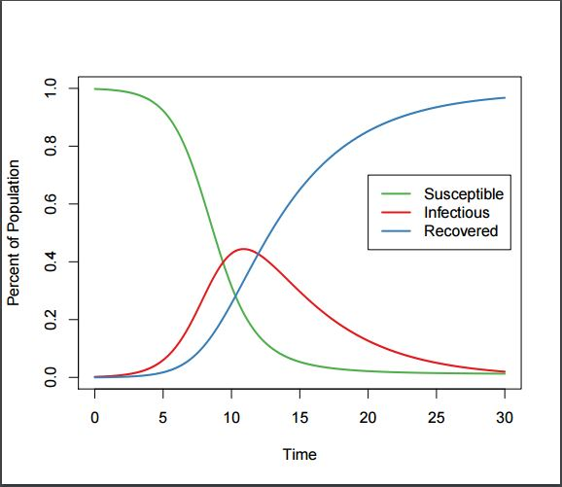
THE SIR MODEL
The fraction of susceptible decreases monotonically as they are infected.
The fraction of infected goes up first as people get infected, then down again, as they recover. Eventually, goes to zero as time tends to infinity.
The fraction of recovered increases monotonically.

Slide 21
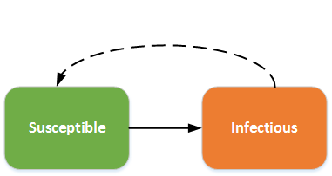
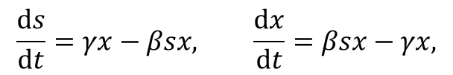
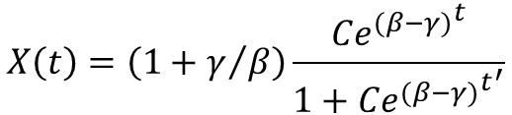
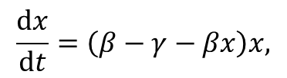
THE SIS MODEL
This model covers the aspect of reinfection for diseases that do not confer immunity on their victims after recovery.
Here,
Putting, s=(1- x),
Solving, we get:
$$\frac{ⅆs}{ⅆt}=γx−βsx, \frac{ⅆx}{ⅆt}=βsx−γx,$$
$$\frac{ⅆx}{ⅆt}=\left(β−γ−βx\right)x,$$
$$X\left(t\right)=\left(1+γ/β\right)\frac{{{Ce}^{(β−γ)}}^{t}}{1+{{Ce}^{(β−γ)}}^{t^{′}}}$$

Slide 22
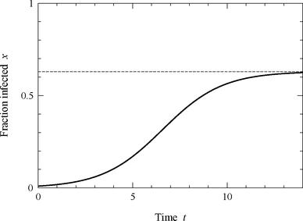
THE SIS MODEL
The fraction of infected individuals grows with time following a logistic growth curve, as in the SI Model.
Unlike the SI model, however, the fraction infected never reaches unity, tending instead to an intermediate value at which the rates of infection and recovery are balanced.

Slide 23
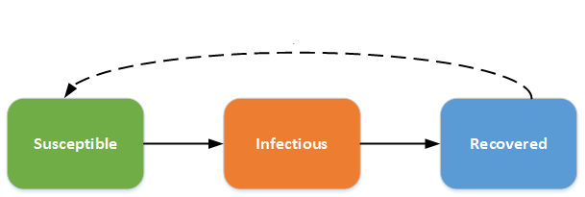
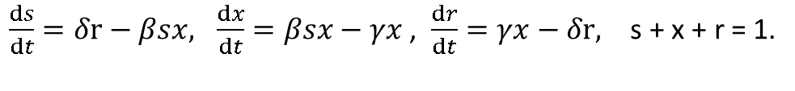
THE SIRS MODEL
In this model, individuals recover from infection and gain immunity.
But this immunity is only temporary and after a certain period of time they become susceptible again.
δ : Average rate at which individuals loose immunity
Here,
$\frac{ⅆs}{ⅆt}=δr−βsx, \frac{ⅆx}{ⅆt}=βsx−γx$, $\frac{ⅆr}{ⅆt}=γx−δr, \text{s}\text{ + }\text{x}\text{ + }\text{r}\text{ = 1}$.

Slide 24
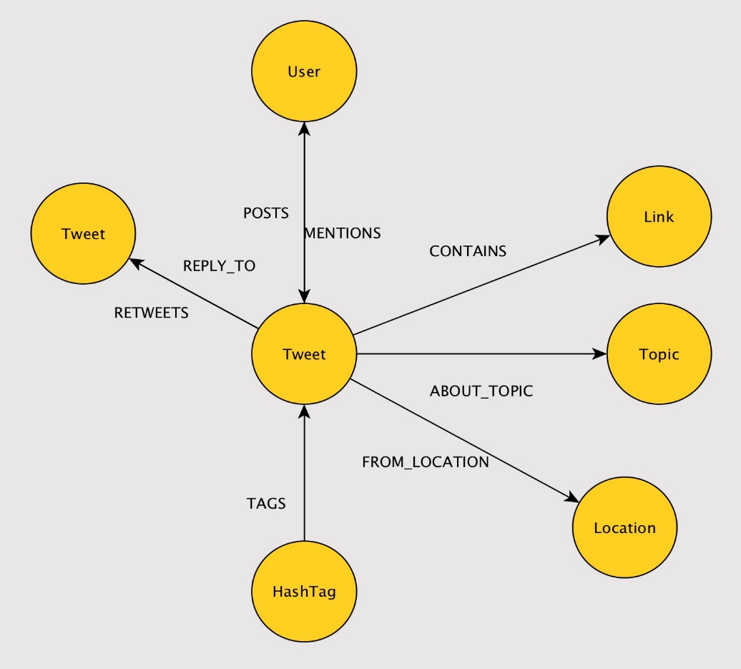
AIM OF THE PROJECT
FEATURES OF TWEETS
Twitter is an online news and social networking service where users post and interact with messages, called "tweets."
Looking at a certain topic, the moment someone tweets something, people have a option of marking it as favourite, retweeting or mentioning that hashtag again.
Out of these, retweeting is the fastest thing people can do, and this provides a simple parameter one can look at.

Slide 25
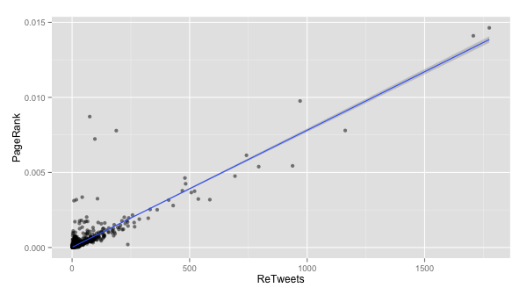
AIM OF THE PROJECT
Tweets scraped to extract information.
The outcome of the analysis is that any tweet that get's retweeted the most shows up first on twitter search. Hence it can be considered as the most influential.
The number of retweets of a certain tweet using a certain hashtag of a topic tells us how many people are being influenced.
Next target is to see how the tweet and that hashtag propagated on a timeline which would give a clear idea about the kind of compartmental model it follows
And then, to verify a mathematical relation between that and a small world model.

